Slide 1

Department of Computer Science & Engineering Smart Segregation System Batch no. 11 1. 2411CS010625(B.Shravani Reddy) 2. 2411CS010637(K.Yuvaraj Singh) 3. 2411CS010657 (G.Dineep Chandra) 4. 2411CS010663(S.Sandeep Reddy) 5.2411CS010670(J.Sangeetha)
Maisammaguda, Kompally, Medchal - Malkajgiri District Hyderabad - 500100, Telangana State. www.mallareddyuniversity.
(Telangana State Private Universities Act No. 13 of 2020 &
G.O.Ms. No. 14, Higher Education (UE) Department)

Slide 2
Table of Contents
Introduction
Abstract
Literature Survey
Limitations of Existing Algorithms/Methodologies
Flowchart
Screenshots Of Application
Hardware/Software Requirements
Conclusion

Slide 3
Introduction
Waste management is one of the most pressing environmental challenges of the 21st century. Rapid urbanization, population growth, and increased industrial activity have led to an exponential rise in waste generation across the globe. Traditional waste management systems rely heavily on manual labor
workers physically inspect bins, sort waste by hand, and schedule pickups on fixed timetables regardless of actual bin fill levels. This approach is inefficient, costly, and environmentally damaging.The Smart Segregation System addresses these challenges by integrating Artificial Intelligence, IoT sensor simulation, and real-time data analytics into a unified web-based platform. The system automatically classifies waste items into five categories — Organic, Recyclable, Hazardous, E-Waste, and Residual
using a combination of image-based object detection and a Java-powered keyword classification engine. Smart bins equipped with simulated IoT sensors continuously report fill levels, temperature, and weight data. When a bin approaches critical capacity, the system automatically generates alerts and enables operators to schedule pickups from the dashboard.

Slide 4
Abstract
The Smart Segregation System is a full-stack AI-powered waste management application designed to automate waste classification, monitor bin fill levels in real-time, and provide actionable analytics for facility operators. The system replaces manual, reactive waste management with an intelligent, proactive, and data-driven approach. It exposes endpoints covering authentication, bin management, alert generation, AI classification, and reporting.
The system correctly handles edge cases such as screenshots, living beings, and functional assets by returning a NON-WASTE_ASSET flag.

Slide 5
Literature Survey
Title: Smart Segregation System
Description: Recent studies highlight the growing importance of smart waste segregation systems due to rapid urbanization and increasing waste generation. A study on IoT-based waste segregation systems explains that traditional waste handling leads to unhygienic conditions and health risks, and proposes automated segregation using sensors to reduce human effort and improve efficiency . Another research work on smart waste detection systems uses components like infrared sensors, inductive sensors, and microcontrollers to classify waste into different categories, showing that automation can significantly enhance accuracy and reduce manual errors.

Slide 6
Limitations of Existing Algorithms/Methodologies
Generic AI Limits: COCO-SSD lacks waste-specific classes, while traditional CNNs require massive datasets and struggle with multi-class items.
Flawed Text Systems: Rule-based keyword models fail on regional synonyms, multi-word inputs, and context modifiers like "broken battery".
IoT Flaws: Physical sensors suffer from high hardware costs, network dropouts, sensor drift (false readings), and unprioritized alerts.
Dashboard Disconnect: Existing platforms are rarely open-source, lack role-based access, and fail to unify classification, monitoring, and reporting

Slide 7
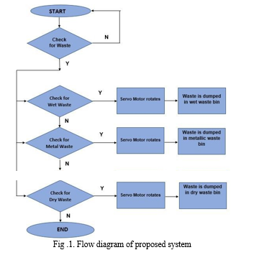
Flowchart

Slide 8
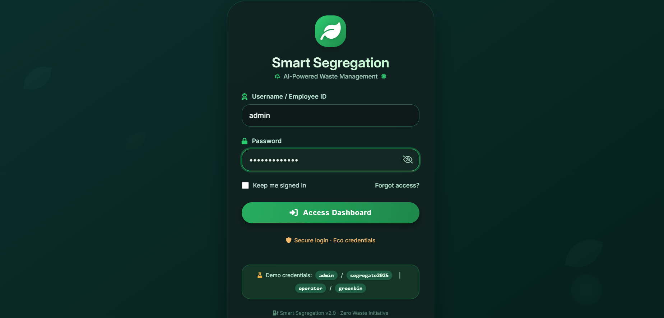
Screenshots
Sign In Page

Slide 9
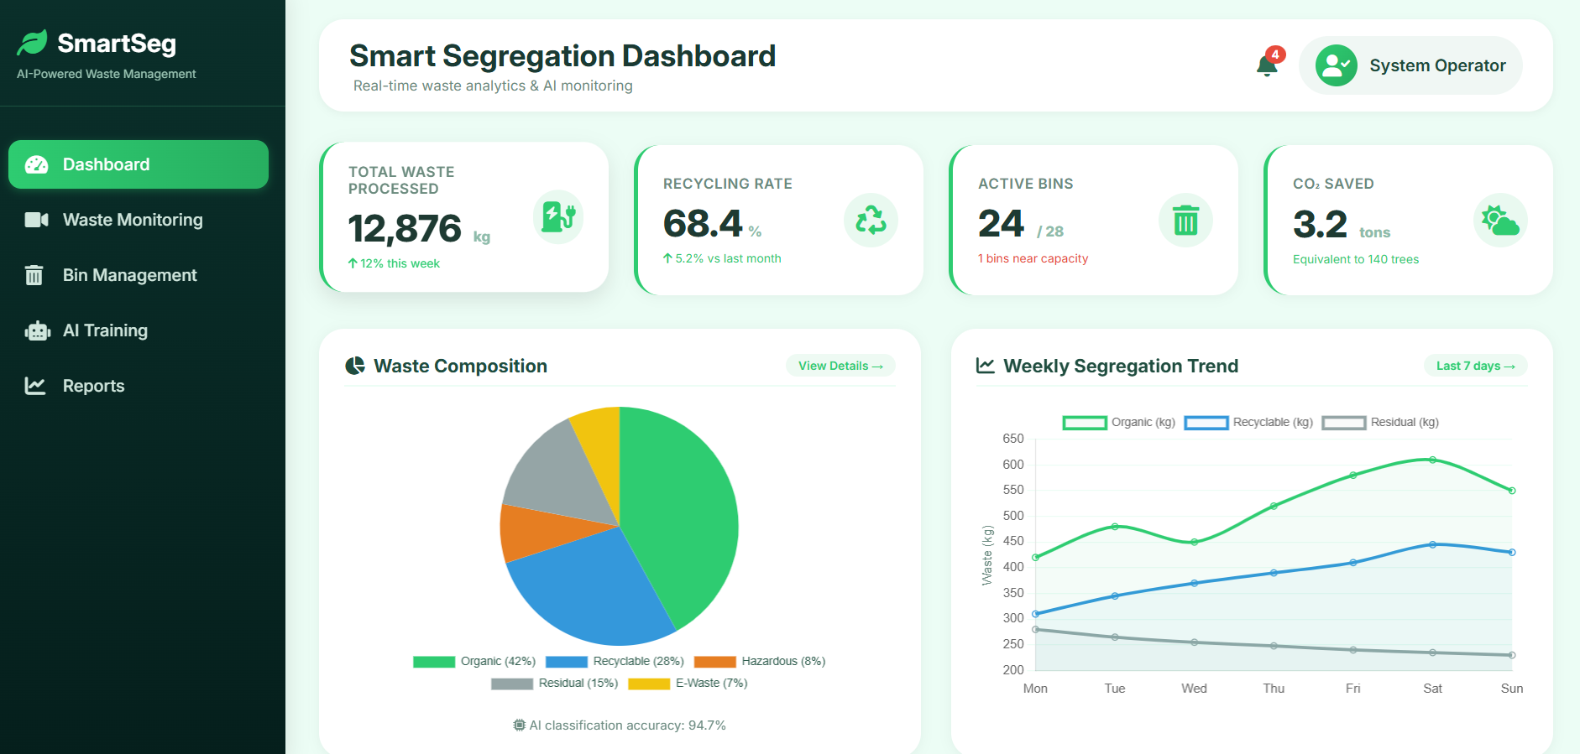
Screenshots
Admin Dashboard

Slide 10
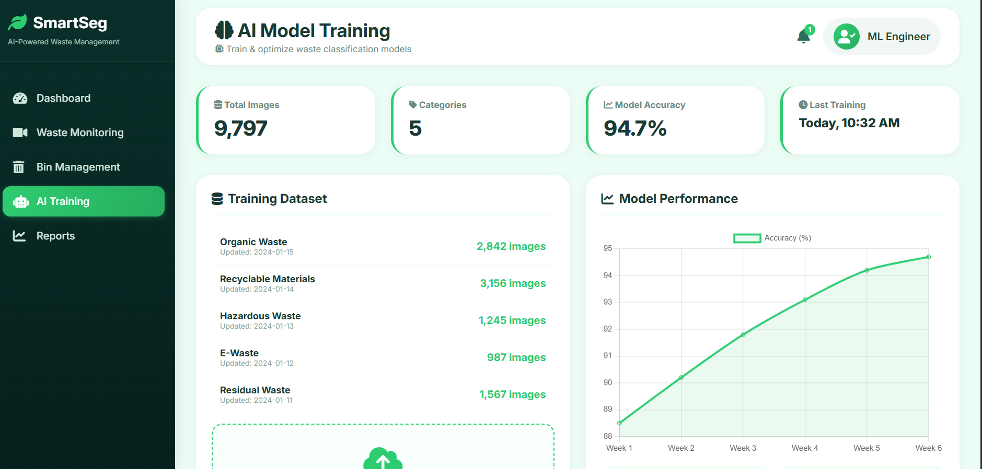
Screenshots
AI Model Training

Slide 11
Hardware/Software Requirements
Hardware Requirements:
Processor: Intel i3 / AMD Ryzen 3 or above
RAM: Minimum 4 GB (8 GB recommended)
Storage: At least 50 GB free disk space

Slide 12
Hardware/Software Requirements
Software Requirements:
Operating System: Windows , Linux, or macOS
Database: MySQL
BACKEND:JAVA
Machine Learning Libraries: Scikit-learn, TensorFlow, or Pandas
Frontend Technologies: HTML, CSS, JavaScript

Slide 13
Conclusion
The Smart Segregation System successfully demonstrates how combining modern software engineering and artificial intelligence can address critical environmental challenges in waste management. By building a clean full-stack Single Page Application using a Java backend, an HTML/CSS/JS frontend, and a persistent MySQL database with secure session management, the project establishes a highly responsive, unified ecosystem.
Key milestones achieved include a real-time IoT simulation managing 10 smart bins across 5 zones with frequent status updates, alongside a robust AI classification engine utilizing over 100 keyword mappings and intelligent screenshot detection to maintain high accuracy and prevent false positives.
Moving forward, the system is well-positioned for future expansion. Transitioning from simulated environments to physical IoT hardware via the MQTT protocol, and replacing generic object detection models with a custom-trained YOLOv8 model dedicated strictly to waste materials, will elevate this platform from a powerful prototype to a production-ready, real-world deployment.

Slide 14
THANK YOU

